Slide 1
Model-Based Classifiers
MSCI:6070 Data Science
Decision Trees

Slide 2
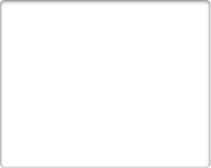
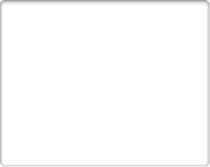
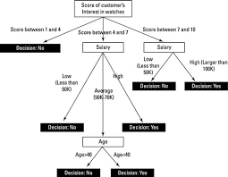
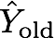
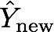
Predictive Modeling
f(X) = Y
Input (X)
Model (f)
Output (Y)
Modeling
Xold
Y
X
Given new data Xnew, What is Ynew?
Predicting
Xnew
A predictive model is a formula learned from old data for estimating the unknown value of interest for some new data

Slide 3
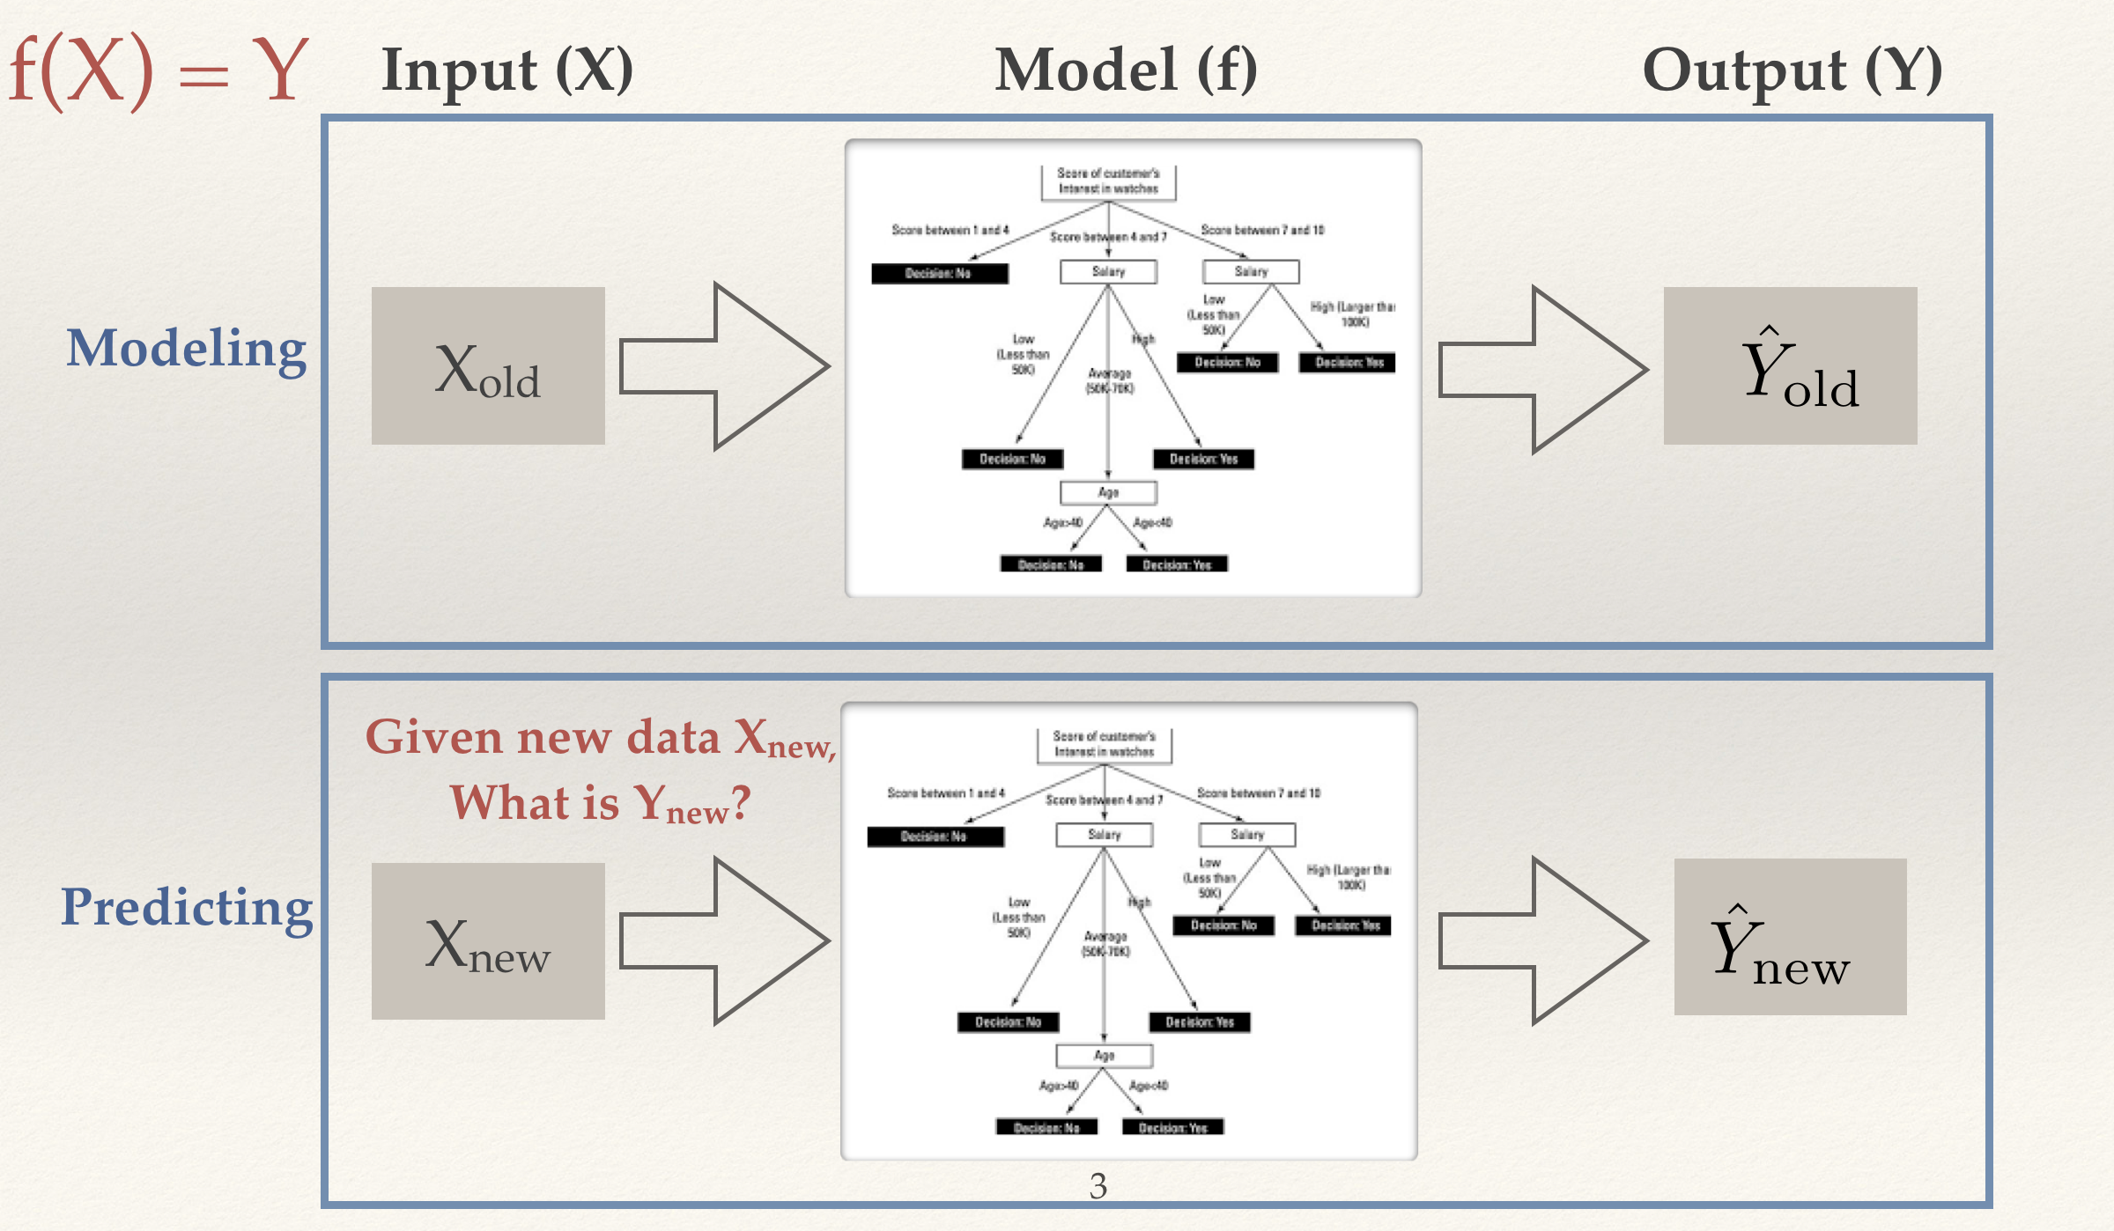
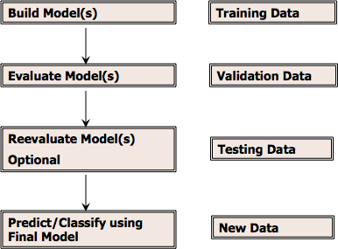
Predictive Modeling
Given (Xold, Yold), build f() — Supervised
Given (Xold), build f() — Unsupervised

Slide 4
Classification
Supervised segmentation
Using informative attributes to segment a population into groups with similar outcome/target
information is a quantity that reduces uncertainty (in the outcome)
We want to choose attributes that make the group pure
certain in the outcome
Selecting Informative Attributes:
How can we judge whether a variable is informative about the target?
How can we obtain a selection of the more informative variables with respect to predicting the value of the target?

Slide 5
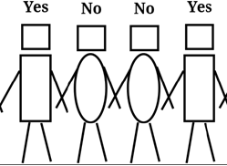
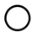
Selecting Informative Attributes
Attributes:
head-shape: square, circle
body-shape: rectangle, oval
body-color: black, white
Target variable: Yes, No
If we split our data according to some variable, we would like the resulting groups to be as pure as possible.
By pure we mean homogeneous with respect to the target variable.
Which feature splits the data into Yes and No groups perfectly?

Slide 6
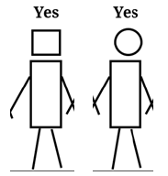
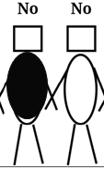
Example
we can obtain two pure groups by splitting according to attribute body shape:
body shape = rectangle
body shape = oval
pure in terms of the target variable

Slide 7
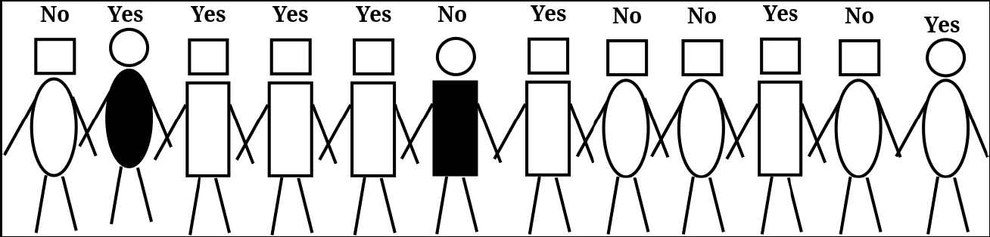

More Data?
body shape = rectangle
5 Yes
1 No
body shape = oval
2 Yes
4 No

Slide 8

More Data?
Compared with splitting on body shape, which one is better (purer)?
head shape = rectangle
5 Yes
4 No
head shape = circular
need a purity measure
2 Yes
1 No

Slide 9
Entropy
Entropy measures uncertainty/impurity. The higher the value, the more uncertain/impure the data is.
Introduced from information theory, created by Claude Shannon. Denoted as H(X)
According to the definition, can you guess which event has higher entropy?
Event A: 100% of the students in this class love data mining
Event B: 50% of the students in this class read the DSB book

Slide 10
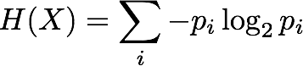
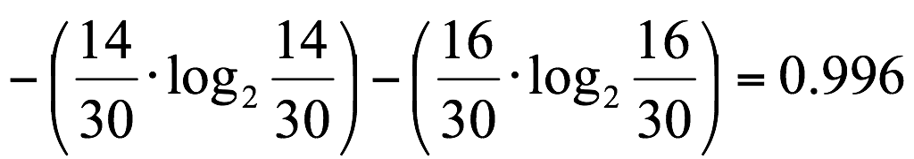
Entropy
Target variable X has two (or more) classes
p1 is the proportion for class 1
p2 is the proportion for class 2,…
Entropy:
Example: Out of 30 people, 16 play Pokemon Go, and 14 do not play, then
H(X) =

Slide 11
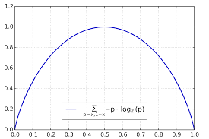
Entropy Function
2 classes
(p, 1-p)
symmetric
maximum at p = 0.5
why?

Slide 12
Entropy
Target Variable:
Yes/No
body shape = rectangle
5 Yes
1 No
body shape = oval
2 Yes
4 No

Slide 13
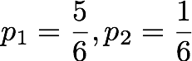
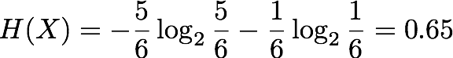
Entropy
Target Variable:
Yes/No
5 Yes
1 No

Slide 14
Entropy
Target Variable:
Yes/No
body shape = rectangle
5 Yes
1 No
body shape = oval
2 Yes
4 No

Slide 15
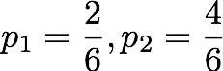
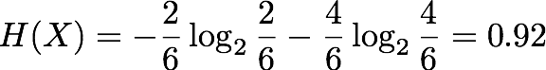
Entropy
Target Variable:
Yes/No
2 Yes
4 No

Slide 16
Practice
The weather forecast says with prob 80% it will rain tmr. What is the entropy of this forecast?
In a medical study, Group A has 70 smokers and 30 non-smokers and Group B has 85 smokers and 15 non-smokers, without computing them, can you tell which group has higher entropy?
Jim is inviting a few friends to his house and he wants to collect information about their attendance. Mike says he will come for 100% sure, Emily says she has 50% chance of coming and John says he is busy and only has 20% chance of coming. Who gives the answer with highest entropy?

Slide 17
So what is entropy?
measure of uncertainty/impurity

Slide 18
Additional Issues about Entropy
Multi-class classification
The base of “log” is the number of classes
Example: 3 Yes, 4 No, 2 Maybe
nclass = 3
p1 = 3/9, p2 = 4/9, p3 = 2/9
Entropy = -p1log3(p1)-p2log3(p2)-p3log3(p3)
Handling continuous attribute
Discretize continuous attribute into intervals
E.g., Original attribute: Temperature = 82.5
New attribute: (temperature > 72.3) = Y, N

Slide 19
Other Impurity Measures
Gini Index
measures how often a randomly chosen element from the set would be incorrectly labeled if it was randomly labeled according to the distribution of labels in the subset.
Gini(X) = 0 when all cases belong to the same class
Max value when all classes are equally represented (=0.5 in binary case)

Slide 20
Which split is better?
Splitting on body shape
Splitting on head shape
body shape = rectangle
body shape = oval
head shape = rectangle
head shape = oval
5 Yes
1 No
2 Yes
4 No
5 Yes
4 No
2 Yes
1 No

Slide 21
Information Gain
InformationGain(parent, children) = Entropy(parent) - Entropy(children)
0.98
Reduced uncertainty/impurity
0.5 * 0.65
0.5 * 0.92
p(child 1)×Entropy(child 1)+p(child 2)×Entropy(child 2)
entropy = 0.98
Parent
body shape = rectangle
body shape = oval
5 Yes
1 No
2 Yes
4 No
child 1
child 2
entropy = 0.65
entropy = 0.92
Notes:
We know how to compute the entropy of one group, what about groups of group
p(child1) is the proportion of child 1

Slide 22
Information Gain
Calculation of information gain (IG):
IG (parent, children) = H(parent)−[p(c1)×H(c1)+p(c2)×H(c2) +…]
Note: Higher IG indicates a more informative split by the variable.
Parent
Child 1
(c1)
Child 2
(c2)
Child…
Notes:
More information is provided for the outcome
Information gained by splitting on a specific attribute
Now remind yourself of the steps again, what you do is you first compute the entropy ….

Slide 23
Practice
IG(parent, children)=H(parent)−[p(c1)×H(c1)+p(c2)×H(c2) +…]
Splitting on head shape
entropy = 0.98
p | H(X)
1/9 | 0.50
2/9 | 0.76
3/9 | 0.92
4/9 | 0.99
head shape = rectangle
head shape = oval
5 Yes
4 No
2 Yes
1 No

Slide 24
Practice
compare age and gender
person id | age>50 | gender | residence | Balance>=50,000 | mortgage payment delay
1 | N | F | own | N | delayed
2 | Y | M | own | Y | not delayed
3 | N | F | rent | N | delayed
4 | Y | M | other | N | not delayed
5 | Y | M | rent | N | not delayed
6 | Y | F | other | Y | not delayed
7 | N | F | rent | Y | delayed
8 | N | F | own | Y | not delayed

Slide 25
0.954434
3 d
5 n
age>50 : Y
age>50 : N
0 d
4 n
3 d
1 n
H(c1) = 0
H(c1) = 0.81
IG = 0.954434 - 0.5*0 - 0.5*0.81 = 0.549434

Slide 26
0.954434
3 d
5 n
gender = M
gender = F
0 d
3 n
3 d
2 n
p(c1) = 3/8
H(c1) = 0
p(c2) = 5/8
H(c2) = 0.9709506
IG = 0.954434 - 3/8*0 - 5/8* 0.9709506 = 0.3475899

Slide 27
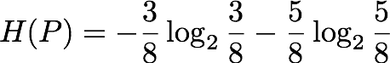
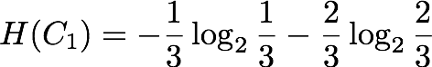
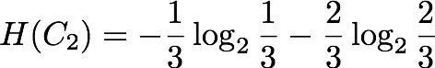
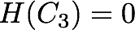
Practice
Example: Split on “residence”
3 d
5 n
residence = own
residence = other
residence = rent
1 d
2 n
2 d
1 n
0 d
2 n

Slide 28
So far…
We have measures of:
Purity of the data (entropy)
How informative a split by a variable is.
We can identify and rank informative variables.
Next – we use this method to build a (model-based) supervised learning classifier – a decision tree.

Slide 29
Tree Induction
body shape = rectangle
body shape = oval
body color = white
body color = black
head shape = circle
head shape = square
What if there are too many features and we cannot eyeball which one to split the data, what is the rigorous way to do it?
Is purity of a node the only thing we care when growing a tree?

Slide 30
Example Data
Y
ID | age>50 | gender | residence | Balance>= 50,000 | mortgage payment delay
1 | N | F | own | N | delayed
2 | Y | M | own | Y | not delayed
3 | N | F | rent | N | delayed
4 | Y | M | other | N | not delayed
5 | Y | M | rent | N | not delayed
6 | Y | F | other | Y | not delayed
7 | N | F | rent | Y | delayed
8 | N | F | own | Y | not delayed
… | … | … | … | … | …
30
14 delayed
6 not delayed
Notes:
Goal: predict payment delay - find a feature to partion the data to make prediction easier

Slide 31
id | age>50 | gender | residence | Bal>=50k | payment
1 | N | F | own | N | delayed
2 | Y | M | own | Y | not delayed
3 | N | F | rent | N | delayed
4 | Y | M | other | N | not delayed
5 | Y | M | rent | N | not delayed
6 | Y | F | other | Y | not delayed
7 | N | F | rent | Y | delayed
8 | Y | F | own | N | delayed
… | … | … | … | … | …
30 | N | F | own | Y | not delayed
id | age>50 | gender | residence | Bal>=50k | payment
1 | N | F | own | N | delayed
3 | N | F | rent | N | delayed
4 | Y | M | other | N | not delayed
5 | Y | M | rent | N | not delayed
8 | Y | F | own | N | delayed
… | … | … | … | … | …
id | age>50 | gender | residence | Bal>=50k | payment
2 | Y | M | own | Y | not delayed
6 | Y | F | other | Y | not delayed
7 | N | F | rent | Y | delayed
… | … | … | … | … | …
30 | N | F | own | Y | not delayed
Information Gain
H(A) = 0.997
All customers
(14 not,16 delay)
Balance≥50,000
Balance<50,000
H(B) = 0.811
(12 not, 4 delay)
(2 not, 12 delay)
H(C) = 0.592
Notes:
you do not need to compute H(parent)
what happens to the dataset? (remember: it’s a partition of data set)
What’s next

Slide 32
H(A) = 0.997
id | age>50 | gender | residence | Bal>=50k | payment
2 | Y | M | own | Y | not delayed
6 | Y | F | other | Y | not delayed
7 | N | F | rent | Y | delayed
… | … | … | … | … | …
30 | N | F | own | Y | not delayed
id | age>50 | gender | residence | Bal>=50k | payment
2 | Y | M | own | Y | not
… | … | … | … | … | …
30 | N | F | own | Y | not
id | age>50 | gender | residence | Bal>=50k | payment
21 | Y | M | other | Y | not delayed
… | … | … | … | … | …
26 | N | F | other | Y | not delayed
id | age>50 | gender | residence | Bal>=50k | payment
12 | Y | M | rent | Y | not
… | … | … | … | … | …
28 | N | F | rent | Y | not
All customers
(14 not,16 delay)
Balance≥50,000
Balance<50,000
H(B) = 0.811
H(C) = 0.592
IG(B, children) = H(B) - [p(c1)H(c1) +…]
(12 not, 4 delay)
(2 not, 12 delay)
Information Gain
Residence = Rent
Residence = Other
Residence = Own
(0 delay, 5 Not)
(1 delay, 5 Not)
(3 delay, 2 Not)

Slide 33
All customers
(14 not,16 delay)
Balance≥50,000
Balance<50,000
Information Gain
(12 not, 4 delay)
(2 not, 12 delay)
Residence = Rent
Age ≥ 50
Age<50
Residence = Own
Residence = Other
(1 delay,2 not)
(11 delay,0 not)
(0 delay, 5 not)
(1 delay, 5 not)
(3 delay, 2 not)
Not
Not
Delayed
Not
Delayed
Notes:
Stopping rule
Leaf label

Slide 34
Recursive Partitioning
Divide-And-Conquer
Recursively apply attribute selection to find the best attribute to partition the data set
The goal at each step is to select an attribute to partition the current group into subgroups that are as pure as possible w.r.t the target variable
Notes:
Why called divide-and-conquer?

Slide 35
How to use the model?
All customers
(14 not,16 delay)
Balance≥50,000
Balance<50,000
(12 not, 4 delay)
(2 not, 12 delay)
Residence = Rent
Age ≥ 50
Age<50
Residence = Own
Residence = Other
(1 delay,2 not)
(11 delay,0 not)
(0 delay, 5 not)
(1 delay, 5 not)
(3 delay, 2 OK)
Not
Not
Delayed
Not
Delayed
person id | age>50 | gender | residence | Balance>=50,000 | delay?
234195 | Y | F | rent | N | ???
532456 | N | M | other | Y | ???
Notes:
Remember this is the modeling part. In predictive modeling, we also care about making predictions.

Slide 36
Agenda
Recursive Partition for building decision trees
Understanding and Interpreting trees
Classification And Regression Tree (CART)
Demo

Slide 37
Feature Space
Age
Balance<50,000
And
Age≥50
A decision tree partitions the feature space into K disjoint sets
Balance≥50,000
And
Age≥40
50
All customers
(14 not,16 delay)
40
Balance≥50,000
Balance<50,000
Balance<50,000
And
Balance≥50,000
And
Age<40
new data
(12 not, 4 delay)
(2 not, 12 delay)
50k
Balance
Age ≥ 40
Age<40
Age ≥ 50
Age<50
Age<50
(1 delay,2 not)
(11 delay,0 not)
(3 delay, 1 not)
(1 delay, 11 not)
Delayed
Not
Not
Delayed
Notes:
=> To visualize the feature space in 2d, let’s pretend the tree we get is …, it has only two variables (age and balance)
What is it? what does this represent?

Slide 38
Trees as Sets of Rules
For any decision tree, there exists an equivalent rule set
Each rule consists of the conditions from tree root to a tree leave, connected with AND
e.g. Balance<50,000 And Age≥50
Rule Sets are unordered

Slide 39
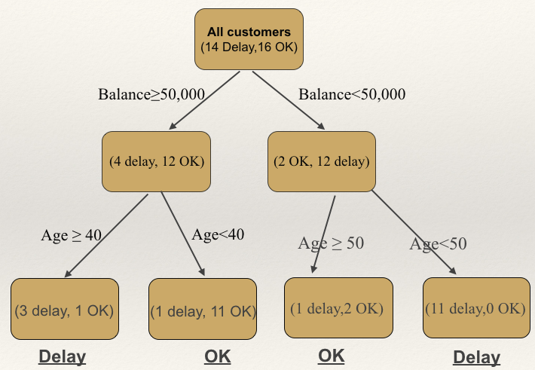
Trees as Sets of Rules
IF (Balance<50k) AND (Age<50) THEN class = Delay
IF (Balance<50k) AND (Age≥50) THEN class = OK
IF (Balance≥50k) AND (Age≥40) THEN class = Delay
IF (Balance≥50k) AND (Age<40) THEN class = OK
Age
Balance<50,000
And
Age≥50
Balance≥50,000
And
Age≥40
50
40
Balance < 50,00
And
Age < 50
Balance≥50,000
And
Age<40
50k
Balance
Notes:
How many rules can a data point satisfy?

Slide 40
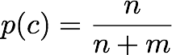
Probability Estimation
Frequency-based estimate
If a leaf contains n positive instances and m negative instances, the probability of any new instance being positive may be estimated as
Overly optimistic
Example: (2 positive, 0 negative) vs (20 positive, 0 negative)
Notes:
extreme, 100%, shld we be willing to say …
an example of a fundamental issue in data science (overfitting)

Slide 41
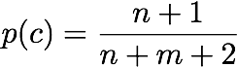
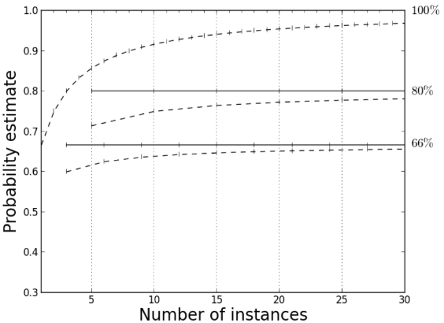
Probability Estimation
Laplace Correction
If a leaf contains n positive instances and m negative instances, the probability of any new instance being positive may be estimated as
If K class: denominator becomes #of examples in the node + K
Example:
(2 positive, 0 negative)
(20 positive, 0 negative)
frequency based
0.75
laplace correction
0.95

Slide 42
Practice
The labels are {Yes, No, Maybe}. What is the probability of getting Yes in the two leaves respectively using Laplace correction?
p(YES) = (3+1)/(3 + 5 + 7 +3)
p(YES) = (3+1)/(3+4+3)
3 Yes
5 No
7 Maybe
3 Yes
4 No

Slide 43
Agenda
Recursive Partition for building decision trees
Understanding and Interpreting trees
Classification And Regression Tree (CART)
Demo

Slide 44
Decision Tree Models
ID3 (Iterative Dichotomiser 3)
C4.5 (successor of ID3)
CART (Classification And Regression Tree)
CHAID (CHi-squared Automatic Interaction Detector). Performs multi-level splits when computing classification trees.[11]
…

Slide 45
Classification and Regression Tree (CART)
Binary tree
Each parent has two child nodes (Y/N)
Is age >= 50?
Y
N
Is residence = rent?
Y
N

Slide 46
Binary Splits
Continuous attributes: find midpoints (or other splitting points) between successive values
Categorical attributes: Examine all possible ways in which the categorical can be split
E.g., categories residence = rent, own, other can be split 3 ways
{rent} and {own, other}
{own} and {rent, other}
{other} and {rent, own}
Is age >= 50?
Y
N
Is residence = rent?
Y
N

Slide 47
Classification and Regression with CART
Classification tree:
discrete output
Attribute selection metric: Gini index
leaf value typically set to the most common value in the leaf
Regression tree:
continuous output
approximate real-valued functions: e.g., the crime rate, the price of a house, the temperature, etc
attribute selection metric: reduced variance/standard deviation
leaf value typically set to the mean value in the leaf

Slide 48
CART for Predicting House Price
Price of a House
0.1m
1m
Age
Each smaller region needs to be homogeneous
Label for each region is the mean of the target variables
0.5 m
0.25 m
0.4 m
5 years
0.3 m
0.45 m
0.75 m
Size
1600 ft²
3000 ft²
Notes:
gradient color from the lightest, which represents lower price, to darkest
what value would you choose?

Slide 49
CART for Predicting House Price
Size >= 3000 ft²
Size < 3000 ft²
Age>=8 years
Age<8 years
Size < 1600 ft²
Size >= 1600 ft²
0.75 m
0.5 m
Age<7 years
Age>=7 years
Age>=5 years
Age<5 years
0.4 m
0.45 m
0.25 m
0.3 m

Slide 50
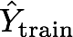
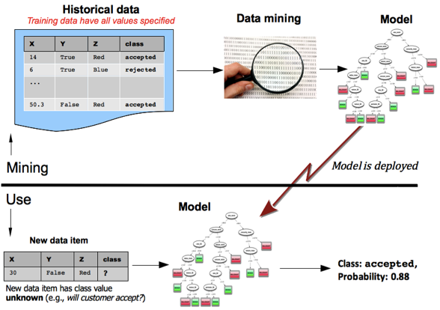
Training Decision Trees
Training model
Xtrain
model f()
Compare Ytrain and
Accuracy on training data is sometimes called “in-sample” accuracy vs “out-of-sample” accuracy (on test data)
Testing
Is this model generalizable to unseen data?
Generalization: performance on “out-of-sample” cases

Slide 51

Training Decision Trees
Predictive Error
What should the curves for training and testing look like?
(will be covered in detail in Chap 5, DSB)
Model complexity

Slide 52
Tree Pruning
Smaller trees are more desirable
Less likely to overfit
Easier to understand
Cheaper to support
Pruning methods
Pre-pruning (top-down)
Stopping criteria while growing the tree
Post-pruning (bottom-up)
Grow the tree, then prune
More popular
Cost-complexity pruning (used by CART): tradeoff error vs complexity
error is obtained by comparing tree’s predictions with the real labels in data
Complexity is measured by tree size
Notes:
Explain overfitting (every node is purer)

Slide 53
Pre-Pruning
Stop the algorithm before it becomes a fully-grown tree
Typical stopping conditions for a node:
Node is pure: observations in the node belong to the same class
Minimum split size reached: the number of observations in the node is lower than a threshold
Minimum leaf size reached: the number of observations in one of the child nodes is lower than a threshold
Maximum depth reached

Slide 54
Post-Pruning
Grow decision tree to its entirety
Trim the nodes of the decision tree in a bottom-up fashion
If generalization error improves after trimming, replace sub-tree by a leaf node
Class label of leaf node is determined from majority class of instances in the sub-tree

Slide 55
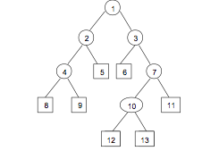
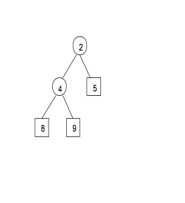
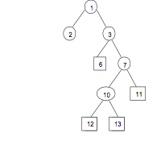
Example of Post Pruning
Tree T
Branch T2
Tree T- T2
Definition: Pruning a branch Tk from a tree T consists of deleting all descendants of k except its root node. T-Tk is the pruned tree.
Performance of the tentative pruned tree T-Tk is evaluated on validation data

Slide 56
Post-Pruning
Cross-Validation
Divide the data into 10 roughly-equal parts, each containing a similar distribution for the target variable.
CART takes 9 parts of the data, constructs the largest possible tree, and uses the remaining 1/10 of the data to obtain initial estimates the cost function
The same process is then repeated on another 9/10 of the data while using a different 1/10 part as the test sample. The process continues until each part of the data has been held in reserve one time as a test sample. The results of the 10 mini-test samples are then combined to form an estimate of performance for trees of each possible size.
Notes:
Draw on whiteboard

Slide 57
Error-Complexity Pruning
General approach: tradeoff error vs complexity
C(T) = Error(T) + α Complexity(T)
C(T) = cost complexity of a tree
Error(T) = error rate (or squared error/variance for regression)
Complexity(T) = complexity of a tree, measured by # of splits
α = penalty factor attached to tree size (set by user)
Among trees of given size, choose the one with lowest C

Slide 58
Advantages of trees
Can cope with any data structure of any type
Classification has a simple and interpretable from
Variable selection & reduction is automatic
Is robust with respect to outliers
Can work without extensive handling of missing data

Slide 59
Disadvantages of trees
May not perform well where there is structure in the data that is not well captured by horizontal or vertical splits
Age
One of the reasons decision trees may not be the most accurate classifier
Balance
Notes:
Explain local optimal

Slide 60
Disadvantages of trees
May not perform well where there is structure in the data that is not well captured by horizontal or vertical splits
Trees can be deceptive - if variable not included it could be as it was “masked” by another
Tree structures may be unstable - a change in the sample may give different trees
Tree is optimal at each split - may not be globally optimal
Notes:
Explain local optimal

